Slide 1

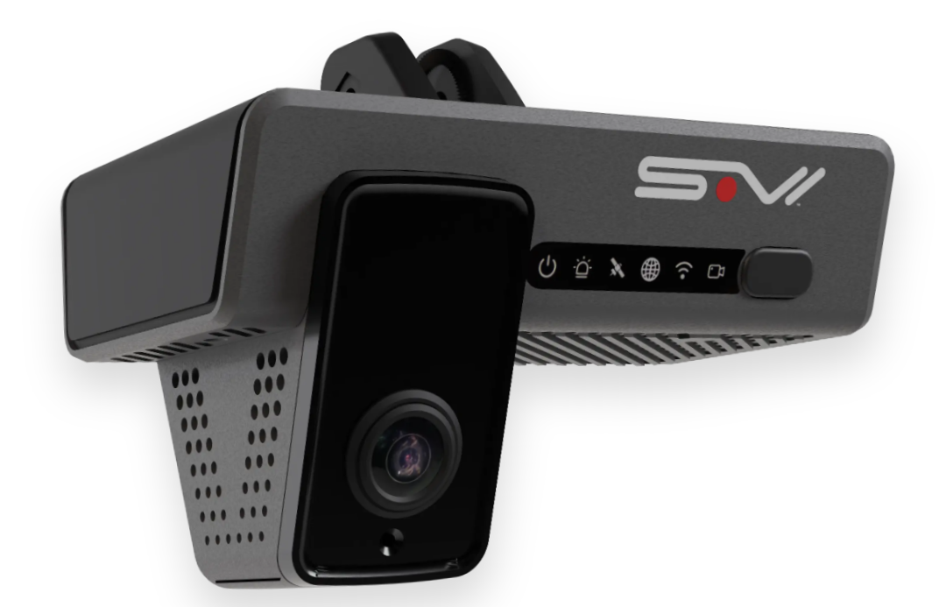




SafeDrive AI
Intelligent Driver Safety & Behavior Analysis System
Dual-Model Computer Vision Platform for Real-Time Detection
Eye Detection
Behavior Analysis
DEPI
2025

Slide 2























The Challenge: Road Safety Crisis
Global Impact
Current Solution Gaps
Industry Costs
1.3M
Lack of real-time capability
$100B+
Existing systems cannot provide immediate alerts
Deaths annually from road accidents
Low accuracy & limited detection
Insurance industry losses annually
Source: WHO, 2024
Poor performance with multi-hazard detection
Key Impacts:
94% caused by human error including drowsiness and distraction
Poor performance in diverse conditions
Rising premiums for all drivers
Inconsistent results across driving environments
Fleets operate without predictive intelligence
Source: NHTSA
Need for comprehensive, real-time solutions
SafeDrive AI • DEPI
2 of 20

Slide 3










Executive Summary
Vision
Reduce driver-related accidents by 40% through AI-powered real-time safety monitoring
Key Achievements
Source: WHO, 2024
40%
Technology
Reduction in driver-related accidents
Integrated dual deep-learning models achieving industry-leading accuracy
98%
|
96%
Accuracy in eye detection & behavior classification
Market Impact
Multi-sector deployment across insurance, automotive, fleet management, and smart cities
Deployment Status
Fully integrated Streamlit platform with real-time alerts and analytics dashboard
SafeDrive AI • DEPI
3 of 20

Slide 4


























Our Solution: SafeDrive AI
A unified computer vision platform that simultaneously detects driver drowsiness and distracted driving behaviors with industry-leading accuracy.
Eye State Detection
Behavior Classification
Unified Integration
(Future work)
MRL Dataset
State Farm Dataset
Multi-Modal Fusion
98%
96%
97%
98% accuracy
96% accuracy
Low end-to-end latency
<100ms/frame latency
10+ behaviors detected
Detects drowsiness via eye closure patterns in real-time analysis
Classifies distracted driving behaviors with multi-angle robustness
Generates risk alerts and actionable safety insights in real-time
Texting
Phone
Eating
SafeDrive AI • DEPI
4 of 20

Slide 5
















System Architecture: Multi-Model Pipeline
Stage 2: DETECTION
Stage 3: ANALYSIS
Stage 4: OUTPUT
Stage 1: INPUT
98%
Risk Assessment & Fusion Engine
Real-Time Alerts & Analytics Data
Real-Time Video Stream
Eye State Drowsiness
96%
Behavior Distraction
Model Architecture
Safety Focus
CNN models (CNN + MobileNetV2)
Real-time risk detection & alerts
SafeDrive AI • DEPI
5 of 20

Slide 6


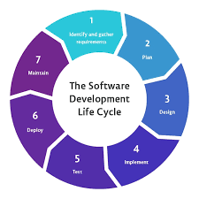



















Phase 1: Requirements & Planning
Software Development Lifecycle Approach
SDLC Cycle
Functional Requirements
Dataset Selection
Real-time detection capability
MRL Dataset (eye state)
Sub-100ms latency requirement
State Farm Dataset (behavior)
>98% accuracy threshold
Architecture Design
Platform Choice
Dual CNN pipelines
TensorFlow/Keras framework
Fusion engine integration
Streamlit deployment
Success Metrics
Accessible web interface
Accuracy
Precision
Recall
F1-Score
Inference Speed
SafeDrive AI • DEPI
6 of 20

Slide 7






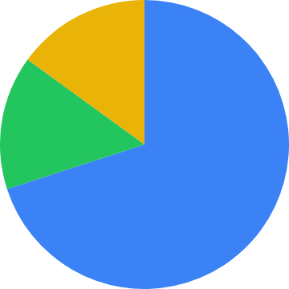



Phase 2: Analysis & Data Preparation
MRL Eye Dataset
State Farm Dataset
84,898
infrared images
22,000+
annotated images
2 classes: Open Eyes / Close Eyes
10 classes: Safe + 9 distracted behaviors
Data Split
Data Split
Train: 70%
Train: 70%
Validation: 15%
Validation: 15%
Test: 15%
Test: 15%
Preprocessing
Preprocessing
Normalization
Augmentation
Histogram equalization
Resize (224×224)
Normalize
Data augmentation
SafeDrive AI • DEPI
7 of 20

Slide 8

















Phase 3: Design - Model Architecture
Transfer learning approach with pre-trained CNN backbones optimized for real-time inference
Model 1: Eye Detection
Model 2: Behavior Classification
Fusion Engine
Input: 128×128×1
Input: 224×224×3
Eye Model
Behavior Model
↓
↓
↓
CNN (4M params)
MobileNetV2 (11M params)
Separated
↓
↓
↓
Output: Open/Close
Output: 10 behaviors
Output: Risk Level + Alert
Accuracy: 98%
Accuracy: 96%
SafeDrive AI • DEPI
8 of 20

Slide 9








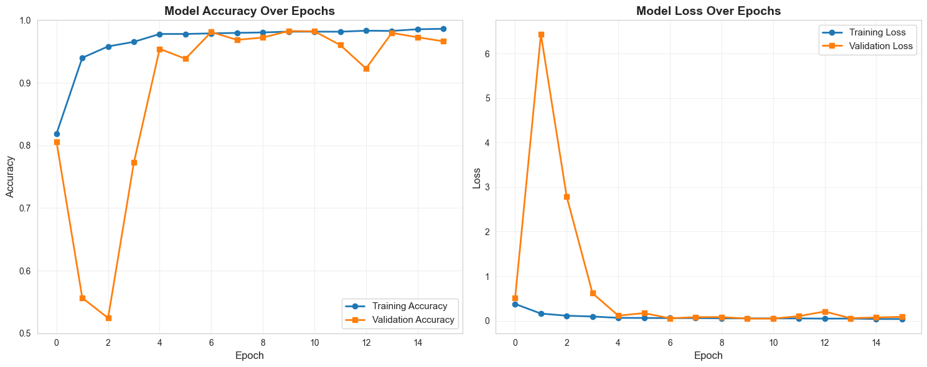
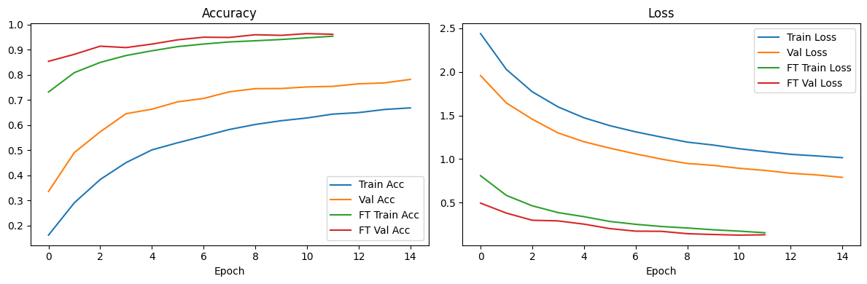
Phase 4: Development & Model Training
Framework: TensorFlow/Keras | Optimization: Adam (lr=0.001) | Loss: Categorical Crossentropy
Eye State Training
Behavior Training
Validation Strategy
Epochs:
50
Epochs:
75
Early Stopping:
Yes (monitor validation loss)
Batch Size:
32
Batch Size:
32
Best Model:
Checkpoint callback
Data Augmentation:
Yes
Data Augmentation:
Yes
Monitoring:
Accuracy + F1-score + AUC
- Random flip, rotation, brightness
- Random crop, zoom, color jitter
Regularization:
Dropout 0.5, L2
Regularization:
L2 (0.0001), Dropout 0.5
Early Stopping:
Patience=10
Early Stopping:
Patience=15
SafeDrive AI • DEPI
9 of 20

Slide 10





Phase 5: Testing - Performance Results
Eye State Detection
Behavior Classification
98%
96%
Accuracy
Accuracy
Precision:
97.8%
Precision:
95.8%
Recall:
98.2%
Recall:
96.1%
F1-Score:
98.0%
F1-Score:
95.9%
Latency:
45ms/frame
Latency:
200ms/frame on CPU
SafeDrive AI • DEPI
10 of 20

Slide 11







Phase 6: Deployment - Architecture & Platforms
Streamlit web application with real-time video processing, analytics dashboard, and multi-stakeholder outputs.
Streamlit Interface
Analytics Module
Future Points
Real-time webcam/video upload
Risk score tracking over time
REST API endpoints for third-party integration
Drag-and-drop file handling
Behavioral pattern recognition
Live detection overlay with bounding boxes
Cloud deployment ready (AWS/Google Cloud/Azure)
Frame-by-frame analysis
Mobile edge support (lightweight model deployment)
Eye State alerts
Third-party integration (telematics, OEM systems)
SafeDrive AI • DEPI
11 of 20

Slide 12
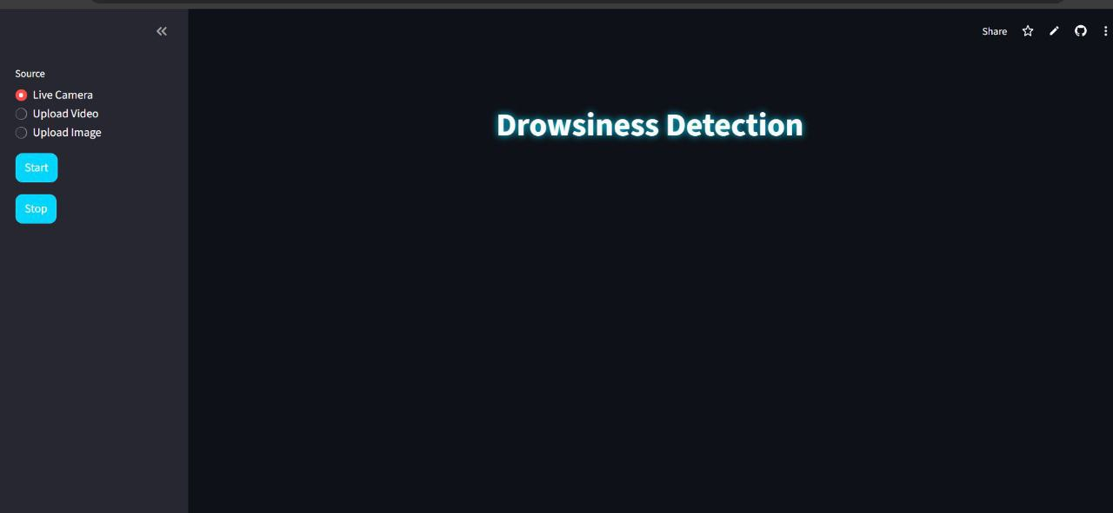
Interface for MRL
SafeDrive AI • DEPI
16 of 20

Slide 13
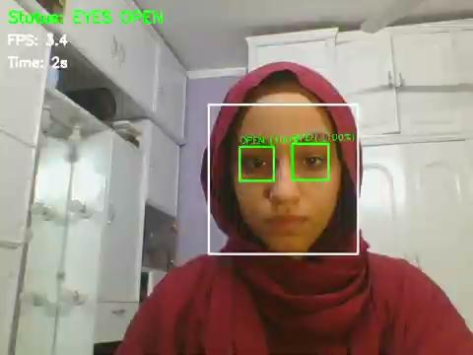
Real-Time Testing: MRL Eye State Detection (First Demo)
Live Demonstration of 98% Accuracy Drowsiness Detection
SafeDrive AI • DEPI
12 of 20

Slide 14
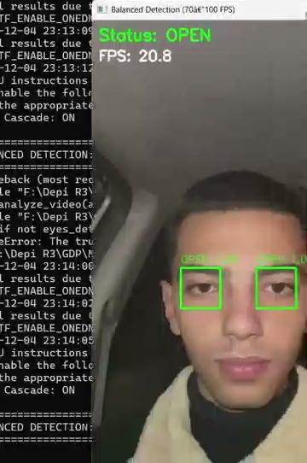
Real-Time Testing: MRL Eye State Detection (Enhanced)
Live Demonstration of 98% Accuracy Drowsiness Detection

Slide 15

Real-Time Testing: State Farm Behavior Classification
Live demonstration of 96% accuracy
SafeDrive AI • DEPI
13 of 20

Slide 16

Real-Time Testing: State Farm Behavior Classification
Live demonstration of 96% accuracy
SafeDrive AI • DEPI
14 of 20

Slide 17
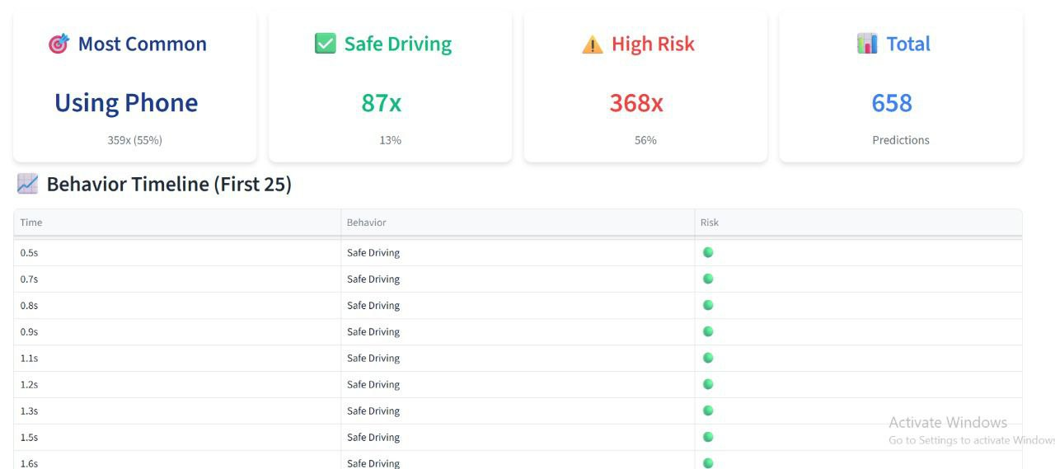
Interface for state farm
SafeDrive AI • DEPI
15 of 20

Slide 18
Future Work
Dataset Expansion & Diversity
Improve generalization and reduce bias regarding lighting conditions, camera angles, and driver appearances.
Collecting diverse dataset covering different genders, behaviours, ages, environments, and camera qualities.
Capturing data across various real-world scenarios such as nighttime driving, reflections, glasses, headwear, and strong sunlight.
Incorporating multiple car models and seating positions to enhance robustness.
Sound Alerts & Full IoT Integration
Extending the system into a full IoT-enabled safety solution:
Adding sound alerts
Integrating with IoT modules
  Smart car dashboard systems
  Raspberry Pi / edge devices
  Cloud-connected monitoring dashboards
Allowing real-time communication between the detection models and vehicle components
SafeDrive AI • DEPI
17 of 20

Slide 19
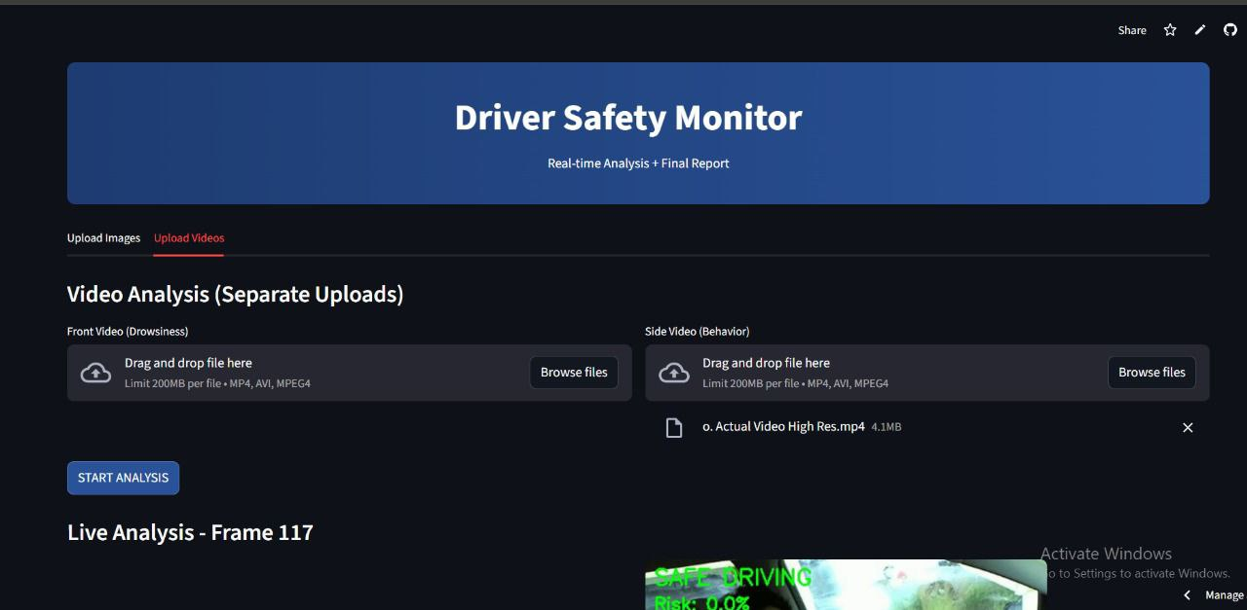
Model Integration
This integration provides:
A fused risk score combining distraction + fatigue signals.
Improved temporal reasoning across both models.
More accurate classification in borderline or ambiguous cases.
Repo 1
Repo 2
SafeDrive AI • DEPI
18 of 20

Slide 20











Real-World Applications: Multi-Sector Impact
Market Size Comparison
Insurance
Automotive
Fleet Management
Smart Cities
USE CASE
USE CASE
USE CASE
USE CASE
Claims assessment & risk profiling
In-vehicle safety system & ADAS support
Driver monitoring & coaching
Road safety infrastructure & incident prevention
BENEFITS
BENEFITS
BENEFITS
Real-time alerts
BENEFITS
Reduce false claims by 30%
Alert driver
Behavioral analytics
Traffic management
Premium differentiation based on behavior
Trigger ADAS
Reduce accidents by 40%
Incident prediction
Support autonomous driving features
Data analytics for urban planning
SafeDrive AI • DEPI
19 of 20

Slide 21













Conclusion: Saving Lives Through AI
SafeDrive AI represents a transformative shift in driver safety. By combining dual high-accuracy detection models with enterprise-grade deployment, we bridge the gap between academic research and real-world impact across insurance, automotive, fleet, and smart city sectors.
Academic Research
Real-World Impact
Innovative AI Models
Multi-Sector Solutions
Insurance
Automotive
Fleet Management
Smart Cities
Claims reduction, risk profiling
Safety systems, ADAS support
Driver coaching, accident reduction
Traffic management, safety infrastructure
Together, let's make every road safer.
SafeDrive AI • DEPI
20 of 20

Slide 22
Thank you!
Any Questions?
SafeDrive AI • DEPI

